Slide 1


now>press>play
MAKE EVERY CHILD’S LEARNING MATTER DEEPLY TO THEM
nowpressplay.co.uk

Slide 2
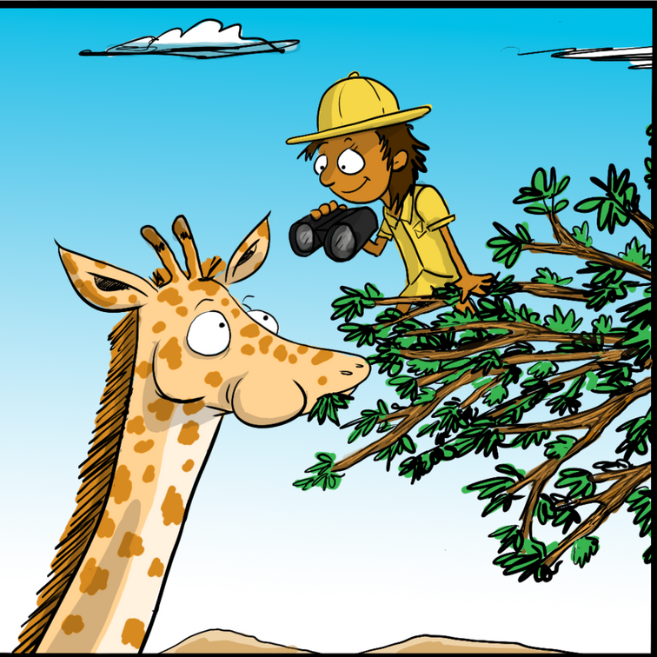

What is now>press>play?
We use the timeless tradition of storytelling to create curriculum-aligned, pedagogically-approved audio adventures that engage pupils in a way that’s both easy and transformative.
Every child, in a class, steps into the world of their learning. They become the main character in an immersive story, moving around the space, meeting people and visiting new places.
now>press>play brings learning to life with over 100 immersive, curriculum-aligned, audio adventures for Nursery to KS2. Proven to boost engagement, empathy, and academic performance, turning learning into an experience is easy - all you have to do is press play.

Slide 3

Core Benefits

Slide 4
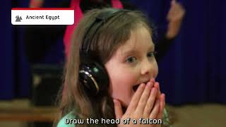
Watch it in action

Slide 5

Complete Setup Guide

Slide 6



What teachers and leadership say
“In my 25 years of teaching I’ve never seen a product have so much impact and generate so much enthusiasm from both staff and pupils.”
"now>press>play is not only a fantastic tool to create excitement for writing... but by using now>press>play, ALL our children - regardless of background - have access to a similar level of knowledge and have the opportunity to succeed.”
“now>press>play puts our pupils on an equal footing; it allows complete inclusivity with a quality shared experience”
- Deb King, Teaching and Learning Lead, Extol Multi Academy Trust
- Martin Bailey, Computing Subject Lead, Birchwood Primary School
- Mark Unwin, CEO
Create Partnership Trust
Click for more

Slide 7
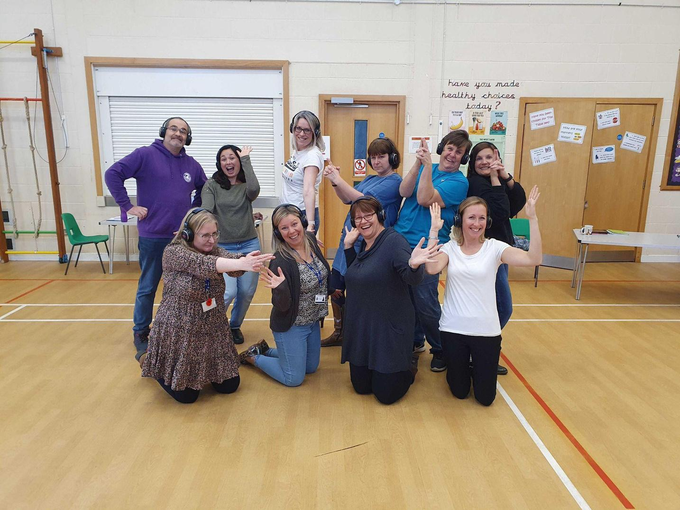
Subscription Support
Your dedicated Customer Success Manager is on hand to support all aspects of your subscription such as:
Milestone-led Onboarding
empowering teachers within your first month
Bespoke Curriculum Mapping
enabling seamless implementation and successful adoption
NPP Champions
Key members of staff to help maximise usage
NPP Sparks
KS2 pupil leadership programme
Live Lessons
Regular live lessons engaging 10,000+ children across the UK
Knowledge Base
Online support section with guides, videos & FAQs and more!

Slide 8
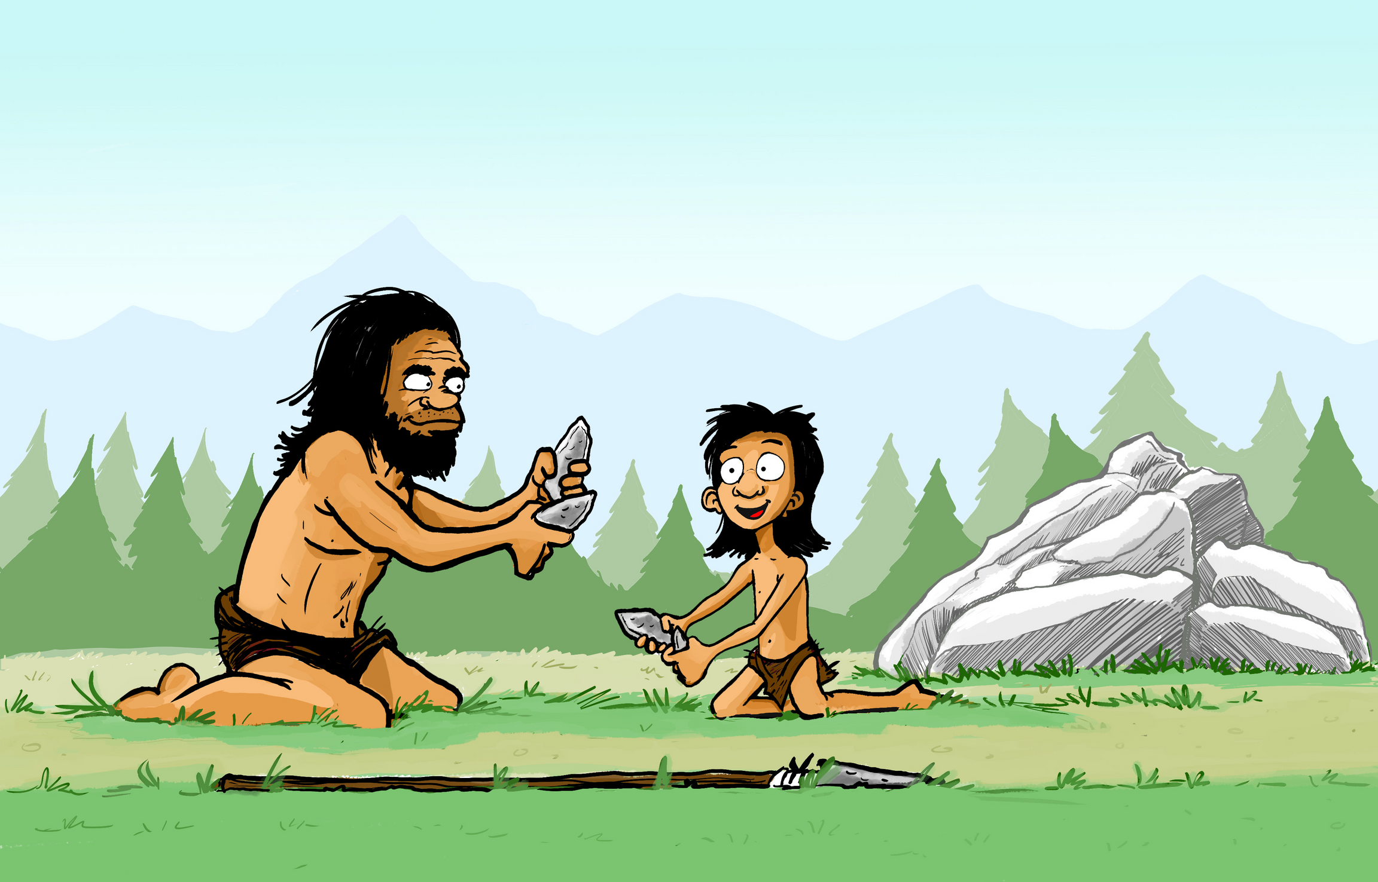
"Using your imagination to learn is better than just being told something."
- Isaac, Year 4 pupil, Chisenhale Primary
“They're not faced with a blank piece of paper and a pencil. They are faced with, ‘Oh I can use my body to do this, I can use my expression and I can act it out.’”
- Sam Ashman, Year 3 teacher, Front Lawn Primary Academy
Call
Email
Visit
+44 (0)203 727 5592
support@nowpressplay.co.uk
https://nowpressplay.co.uk

